Slide 1
Cloud Computing
SEWP ZG527

Slide 2
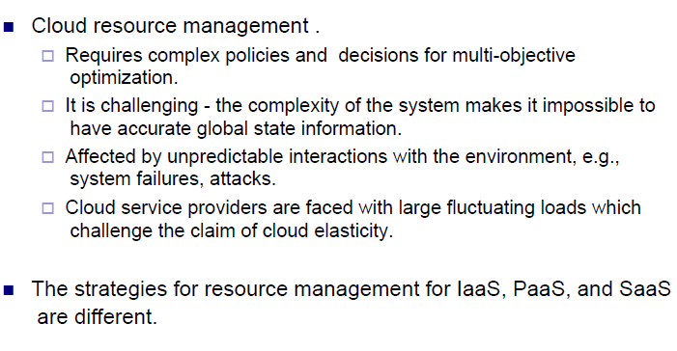
Capacity Management Challenges

Slide 3
Capacity Planner Goal
The goal of capacity planners is to identify significant & vital resources that have resource ceiling & add more resources to move the restricted access to higher levels of demand.
Network capacity is one of the hardest factors to resolve & the performance of the network is affected by I/O of the network at the server & network traffic from cloud to ISPs (Internet Service Providers).
Capacity planners try to find the solution to meet future demands on a system by providing additional capacity to fulfill those demands. Capacity planning & system optimization are two both different concepts, and you mustn't mix them as one. Performance & capacity are two different attributes of a system. Cloud 'capacity' measures & concerns about how much workload a system can hold whereas 'performance' deals with the rate at which a task get performed

Slide 4
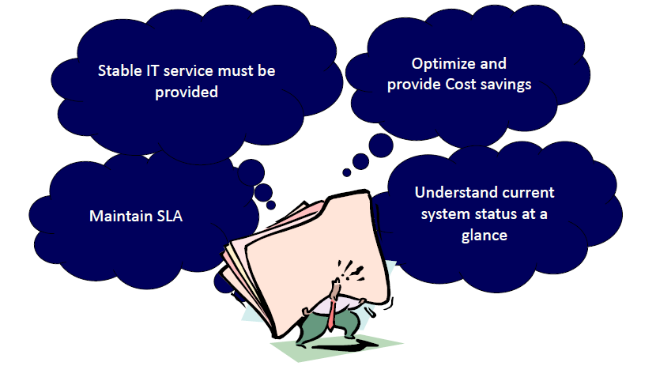
Why Capacity Management

Slide 5
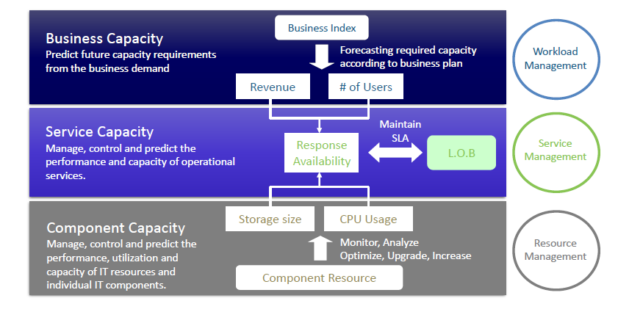
Capacity Management Building Blocks

Slide 6
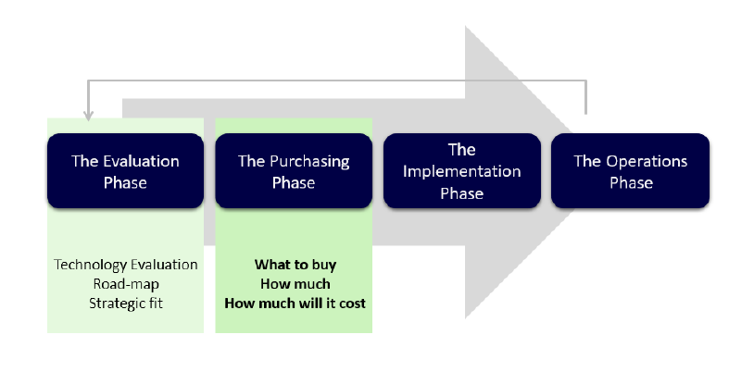
Cloud Deployment Model

Slide 7
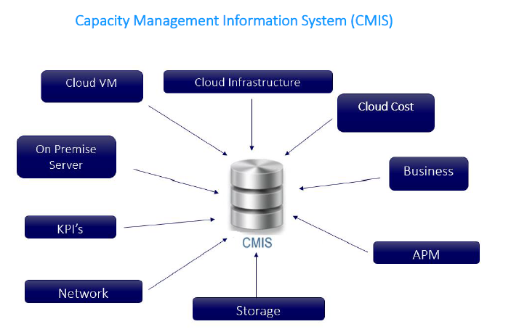
Cloud Management

Slide 8
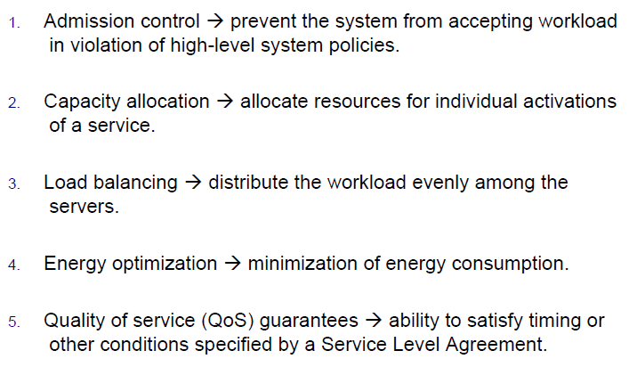
Capacity Resource Management Policies

Slide 9
Capacity Planning Steps
Determine the distinctiveness of the present system.
Determine the working load for different resources in the system such as CPU, RAM, network, etc.
Load the system until it gets overloaded; & state what's requiring to uphold acceptable performance.
Predict the future based on older statistical reports & other factors.
Deploy resources to meet the predictions & calculations.
Repeat step (i) through (v) as a loop.

Slide 10
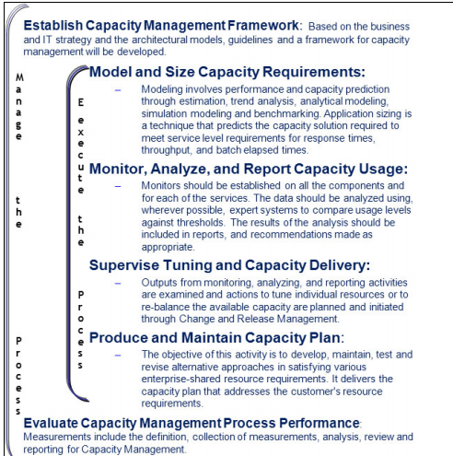
Capacity Management Framework

Slide 11
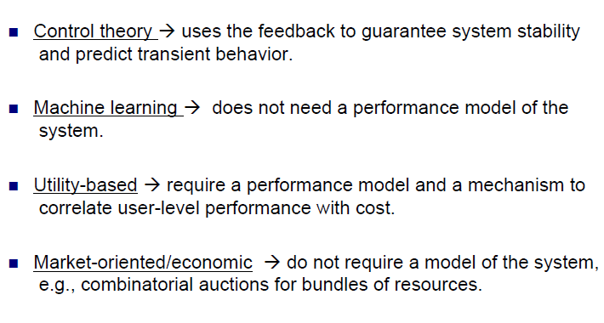
Implementation Capacity Resource Management Policies

Slide 12
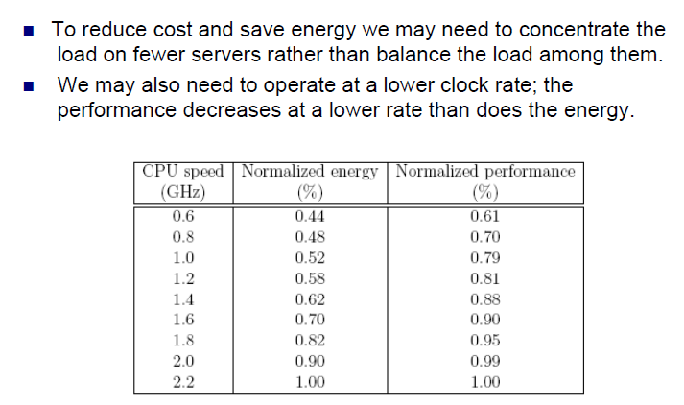
Trade offs

Slide 13
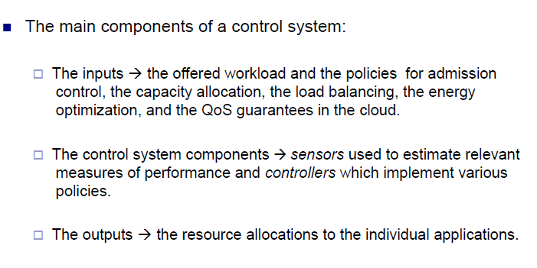
CRM Control Policies

Slide 14
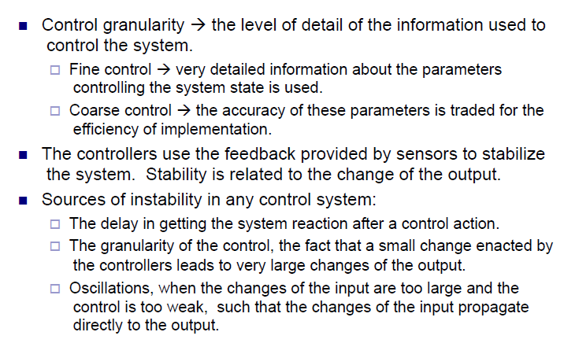
Feedback and Stability

Slide 15
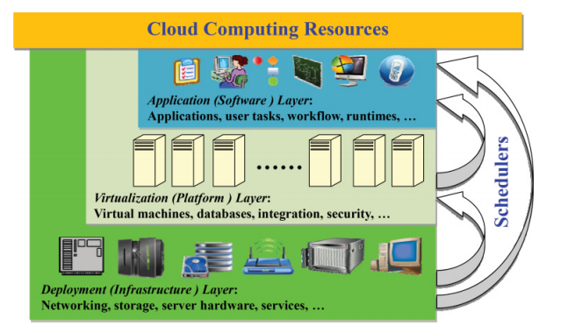
Cloud Resource Scheduling
—Scheduling in the application layer is to schedule the virtual or physical resources
to support software and user applications, tasks, and workflows, etc., with optimal
QoS and efficiency.
—Scheduling in the virtualization layer focuses on mapping virtual resources onto
physical resources with optimal load balance, energy conservation, etc.
—Scheduling in the deployment layer, which also attracts worldwide attention, is concerned with optimal and strategic infrastructure, outsourcing, service placement,
multicloud centers, partnering, data routing and application migration, etc

Slide 16
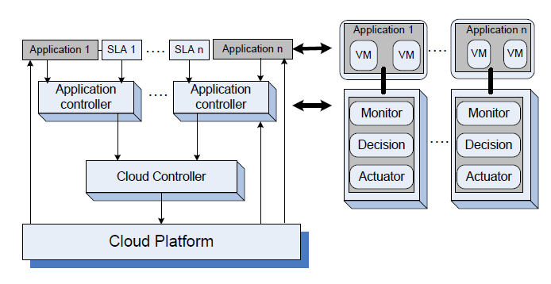
Cloud Control Level

Slide 17
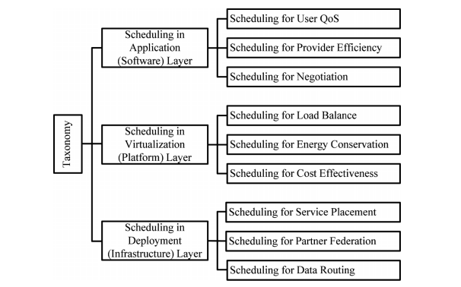
Cloud Resource Scheduling

Slide 18
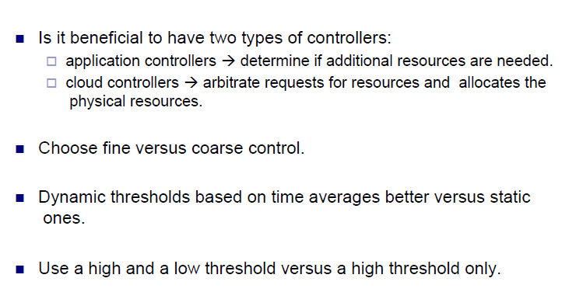
Design Considerations

Slide 19
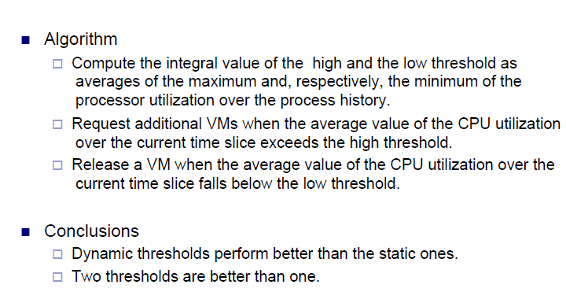
Proportional Thresholding's

Slide 20
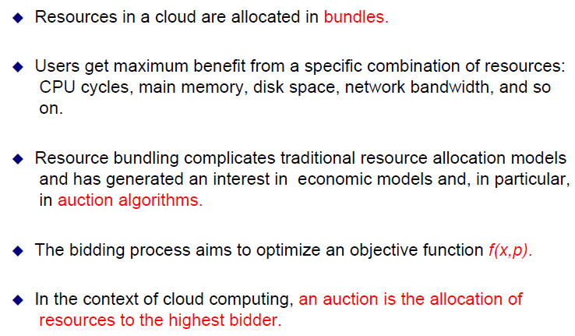
Resource Bundlings

Slide 21
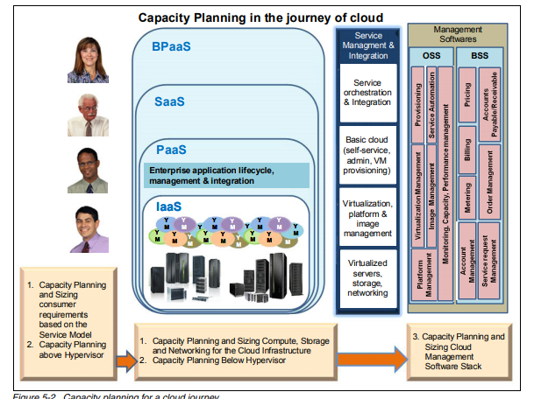
Capacity Management Capacity Journey

Slide 22
Capacity Modelling
Capacity modeling involves categorization and characterization of entities involved in the
end-to-end cloud infrastructure. There are many factors that need to be correlated to come up
with the correct estimation model to provide optimal service to the consumers. Historical and
live data need to be analyzed to forecast future requirements and to identify patterns to
service different workloads efficiently. This is applicable for both the cloud consumer and
provider:
1. Identify the tenancy model (single tenancy, multi-tenancy model).
2. Identify the performance characterization and volumetrics of the application with respect
to tenancy model.
3. Identify the workload deployment type (development, test, and production).
4. Identify the correct servers and platform for your application requirements.
5. Analyze the CPU, memory, storage, and network requirements (minimum, average, and
maximum).
6. Consider I/O usage versus CPU usage versus memory usage versus virtualization
processing.
7. Consider the resource sharing requirements (dedicated or shared).

Slide 23
Cloud Application baselines
The first thing that strikes in mind while dealing with the business issue is the system's capacity or working load as a measurable quantity over time, since many developers build their cloud-based applications & websites based on the LAMP. The full-form is extracted below:
Linux - operating system
Apache - Apache Software Foundation's Web-server
MySQL - database server
PHP - Hypertext Preprocessor
The above four technologies are open-source although the distribution may vary from cloud to cloud. There are other slight variations of the LAMP that are available for development. These are:
OpAMP (OpenBSD Apache MySQL PHP)
SAMP (Solaris Apache MySQL PHP)
WAMP (Windows Apache MySQL PHP)

Slide 24
Baseline measurement
There are two important work-load matrices in the LAMP system. These are:
Page view: is the number of hits on a website & is measured in hits per second
Transactions: is measured by transactions per second and is the number of queries the database server completes per second

Slide 25
Load Test
Server administrator checks for servers under load for system metrics to give capacity planners enough information to do significant capacity planning. Capacity planners should know about the increase in load to the system. Load-testing needs to query the following questions:
What is the optimum load that the system can support?
What system blocks the current system & limits the system's performance?
Can the configuration be altered in the server to use capacity?
How will the server react concerning performance with other servers having different characteristics?

